Slide 1
Introduction to Object Oriented Programming and Methodology
By
SMITA SANKHE
Assistant Professor
Department of Computer Engineering
K. J. Somaiya College of Engineering
Somaiya Vidyavihar University

Slide 2
Tutorial 2

Slide 3
Outline
Read input from user:
Command line interpreter
Buffered reader Class
Scanner Class
Static variable, method, class
Operators in Java
Control Statements

Slide 4
To read input Data : 1. command line interpreter
Class Sample
{
public static void main(String args[]) {
For(int i=0;i<args.length();i++)
System.out.println(args[i]);
}
}

Slide 5
To read input Data : 2. Using BufferedReader and InputStreamReader
import java.io.*;
class Sample{
public static void main(String args[])throws Exception
{
BufferedReader br=new BufferedReader(new InputStreamReader(System.in));
System.out.println("Enter your name");
String name=br.readLine();
System.out.println("Welcome "+name);
System.out.println("Enter your number");
int n=Integer.parseInt(br.readLine());
System.out.println(“Number is "+n);
}
}

Slide 6
Using BufferedReader and InputStreamReader (Contd)…
InputStreamReader class
InputStreamReader class can be used to read data from keyboard. It performs two tasks:
connects to input stream of keyboard
converts the byte-oriented stream into character-oriented stream
BufferedReader class
BufferedReader class can be used to read data line by line by readLine() method.
System.in
When you type a value in a program, to retrieve it, you can store in the in object of the System class .

Slide 7
To read input Data 3. Using Scanner class
import java.util.Scanner;
class Sample{
public static void main(String args[]){
Scanner sc=new Scanner(System.in);
System.out.println("Enter your id");
int id=sc.nextInt();
System.out.println("Enter your name");
String name=sc.nextLine();
System.out.println("Enter your salary");
double salary=sc.nextDouble();
System.out.println(“Id:"+id+" name:"+name+" Salary:"+salary);
sc.close();
}

Slide 8
Using Scanner class(contd..)
The Java Scanner class breaks the input into tokens using a delimiter that is whitespace by default. It provides many methods to read and parse various primitive values.
Method | Description
public String next() | it returns the next token from the scanner.
public String nextLine() | it moves the scanner position to the next line and returns the value as a string.
public byte nextByte() | it scans the next token as a byte.
public short nextShort() | it scans the next token as a short value.
public int nextInt() | it scans the next token as an int value.
public long nextLong() | it scans the next token as a long value.
public float nextFloat() | it scans the next token as a float value.
public double nextDouble() | it scans the next token as a double value.

Slide 9
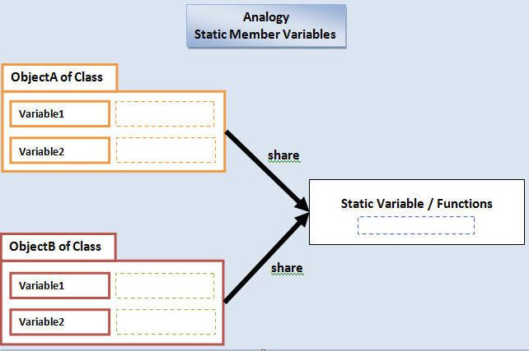
Static variable
When a variable is declared with the keyword “static”, its called a “class variable”.
All instances share the same copy of the variable. A class variable can be accessed directly with the class, without the need to create a instance. It makes your program memory efficient.

Slide 10
Example
class Counter{
int count=0;//will get memory when instance is
created
Counter(){
count++;
System.out.println(count);
}
public static void main(String args[]){
Counter c1=new Counter();
Counter c2=new Counter();
Counter c3=new Counter();
}
} Output:1 1 1
Since instance variable gets the memory at the time of object creation, each object will have the copy of the instance variable, if it is incremented, it won't reflect to other objects. So each objects will have the value 1 in the count variable.
class Counter2{
static int count=0;//will get memory only once and retain its value
Counter2(){
count++;
System.out.println(count);
}
public static void main(String args[]){
Counter2 c1=new Counter2();
Counter2 c2=new Counter2();
Counter2 c3=new Counter2();
}
} Output:1 2 3
static variable will get the memory only once, if any object changes the value of the static variable, it will retain its value. So its value is incremented

Slide 11
Static method
A static method belongs to the class rather than object of a class.
A static method can be invoked without the need for creating an instance of a class.
static method can access static data member and can change the value of it.
There are two main restrictions for the static method. They are:
The static method can not use non static data member or call non-static method directly.
this and super cannot be used in static context

Slide 12
Example
class Difference {
public static void main(String[] args)
{
display(); //calling without object
Difference t = new Difference();
t.show(); //calling using object
}
static void display() { System.out.println("Programming is amazing."); }
void show(){
System.out.println("Java is awesome.");
}
}
If you wish to call static method of another class then you have to write class name while calling static method

Slide 13
Static block
Is used to initialize the static data member.
It is executed before main method at the time of classloading.
So this is one of the way to execute a program without main() method
class A2{
static{System.out.println("static block is invoked");}
public static void main(String args[]){
System.out.println("Hello main");
}
} OUTPUT: static block is invoked
Hello main

Slide 14
Operators in Java
Operator in java is a symbol that is used to perform operations.
For example: +, -, *, / etc.
There are many types of operators in java which are given below:
Unary Operator
Arithmetic Operator
Shift Operator
Relational Operator
Bitwise Operator
Logical Operator
Ternary Operator
Assignment Operator

Slide 15
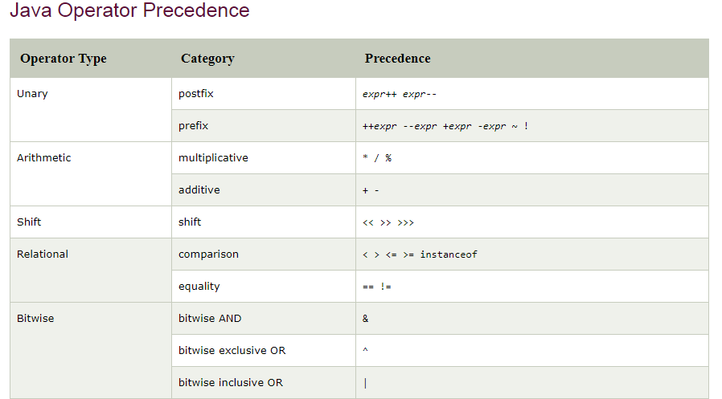

Slide 16
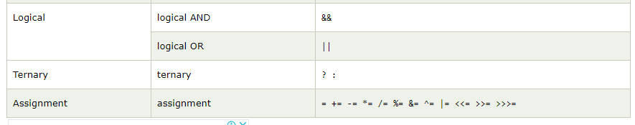

Slide 17
Control STATEMENTS
Selection Statements
Using if and if...else
Nested if Statements
Using switch Statements
Conditional Operator
Repetition Statements
Looping: while, do-while, and for
Nested loops
Using break and continue

Slide 18
Selection Statements
if Statements
switch Statements

Slide 19
if Statements
if (booleanExpression)
{
statement(s);
}
Example:
if ((i > 0) && (i < 10))
{
System.out.println("i is an " +
"integer between 0 and 10");
}

Slide 20
Note:
Adding a semicolon at the end of an if clause is a common mistake.
if (radius >= 0);
{
area = radius*radius*PI;
System.out.println(
"The area for the circle of radius " +
radius + " is " + area);
}
This mistake is hard to find, because it is not a compilation error or a runtime error, it is a logic error.
Wrong

Slide 21
The if...else Statement
if (booleanExpression)
{
statement(s)-for-the-true-case;
}
else
{
statement(s)-for-the-false-case;
}

Slide 22
if...else Example
if (radius >= 0)
{
area = radius*radius*PI;
System.out.println("The area for the “
+ “circle of radius " + radius +
" is " + area);
}
else
{
System.out.println("Negative input");
}

Slide 23
Multiple Alternative if Statements
if (score >= 90)
grade = ‘A’;
else
if (score >= 80)
grade = ‘B’;
else
if (score >= 70)
grade = ‘C’;
else
if (score >= 60)
grade = ‘D’;
else
grade = ‘F’;
if (score >= 90)
grade = ‘A’;
else if (score >= 80)
grade = ‘B’;
else if (score >= 70)
grade = ‘C’;
else if (score >= 60)
grade = ‘D’;
else
grade = ‘F’;

Slide 24
Note
The else clause matches the most recent if clause in the same block. For example, the following statement
int i = 1; int j = 2; int k = 3;
if (i > j)
if (i > k)
System.out.println("A");
else
System.out.println("B");
is equivalent to
int i = 1; int j = 2; int k = 3;
if (i > j)
if (i > k)
System.out.println("A");
else
System.out.println("B");

Slide 25
Note: (cont.)
Nothing is printed from the preceding statement. To force the else clause to match the first if clause, you must add a pair of braces:
int i = 1;
int j = 2;
int k = 3;
if (i > j)
{
if (i > k)
System.out.println("A");
}
else
System.out.println("B");
Output: B.

Slide 26
Switch Statement
The Java switch statement executes one statement from multiple conditions. It is like if-else-if ladder statement.
The switch statement works with byte, short, int, long, enum types, String
Example:
This program reads in number of years and loan amount and computes the monthly payment and total payment. The interest rate is determined by number of years.

Slide 27
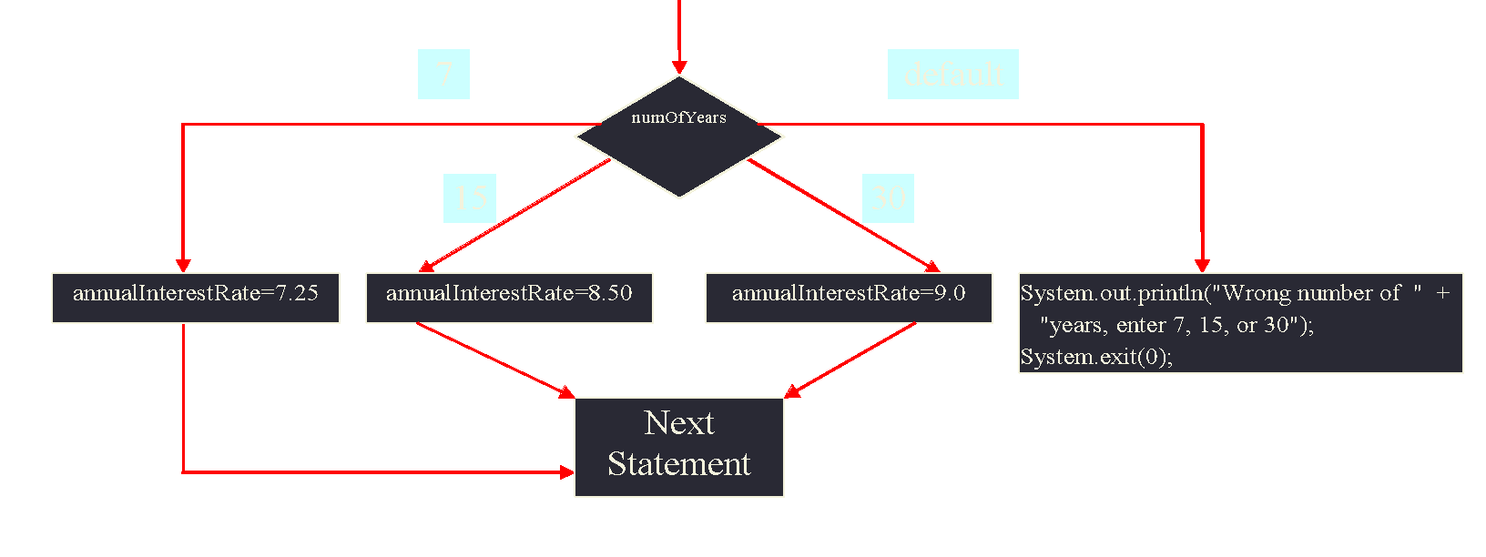
switch Statements
switch (year) {
case 7: annualInterestRate = 7.25;
break;
case 15: annualInterestRate = 8.50;
break;
case 30: annualInterestRate = 9.0;
break;
default: System.out.println(
"Wrong number of years, enter 7, 15, or 30");
}

Slide 28
switch Statement Rules
The switch-expression must yield a value of char, byte, short, or int type and must always be enclosed in parentheses.
The value1, ..., and valueN must have the same data type as the value of the switch-expression.
The resulting statements in the case statement are executed when the value in the case statement matches the value of the switch-expression. (The case statements are executed in sequential order.)
The keyword break is optional, but it should be used at the end of each case in order to terminate the remainder of the switch statement.
If the break statement is not present, the next case statement will be executed.

Slide 29
switch Statement Rules, cont.
The default case, which is optional, can be used to perform actions when none of the specified cases is true.
The order of the cases (including the default case) does not matter. However, it is a good programming style to follow the logical sequence of the cases and place the default case at the end.

Slide 30
Note:
Do not forget to use a break statement when one is needed. For example, the following code always displays Wrong number of years regardless of what numOfYears is.
switch (numOfYears) {
case 7: annualInterestRate = 7.25;
case 15: annualInterestRate = 8.50;
case 30: annualInterestRate = 9.0;
default: System.out.println("Wrong number of years");
}

Slide 31
Repetitions
while Loops
do-while Loops
for Loops
for each loops
break and continue

Slide 32
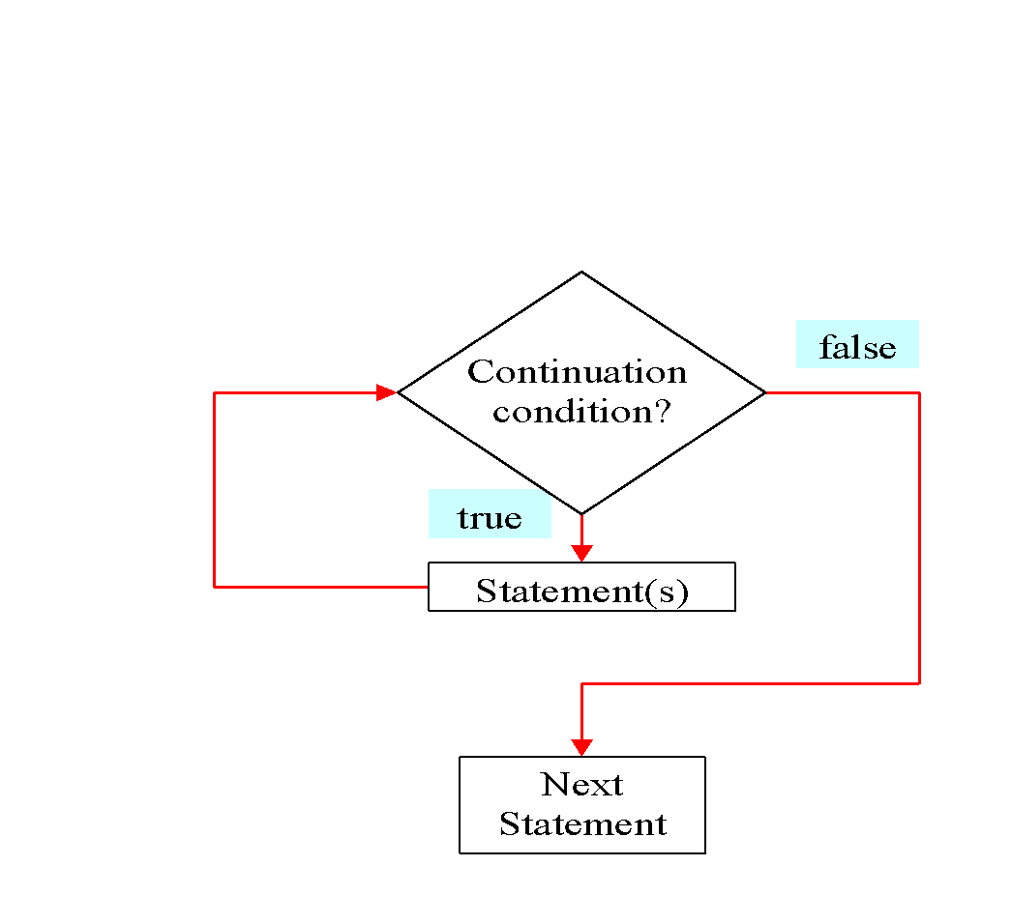
while Loop Flow Chart
while (continuation-condition) {
// loop-body;
}

Slide 33
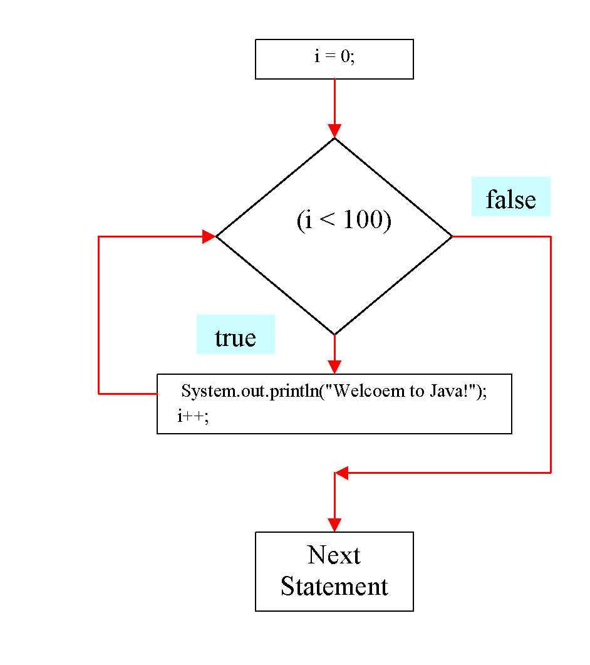
Example:
int i = 0;
while (i < 100) {
System.out.println(
"Welcome to Java!");
i++;
}

Slide 34
Note:
Don’t use floating-point values for equality checking in a loop control.
Since floating-point values are approximations, using them could result in imprecise counter values and inaccurate results.
This example uses int value for data. If a floating-point type value is used for data, (data != 0) may be true even though data is 0.
// data should be zero
double data = Math.pow(Math.sqrt(2), 2) - 2;
if (data == 0)
System.out.println("data is zero");
else
System.out.println("data is not zero");

Slide 35
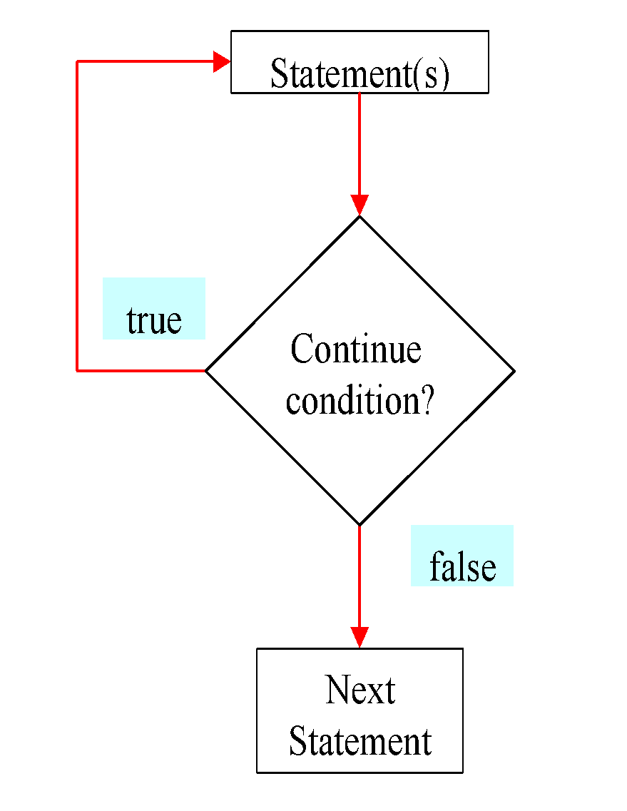
do-while Loop
do {
// Loop body;
} while (continue-condition);

Slide 36
for Loops
for (initial-action; loop-continuation-condition; action-after-each-iteration) {
//loop body;
}
int i = 0;
while (i < 100)
{
System.out.println("Welcome to Java! ” + i);
i++;
}
Example:
int i;
for (i = 0; i < 100; i++)
{
System.out.println("Welcome to Java! ” + i);
}

Slide 37
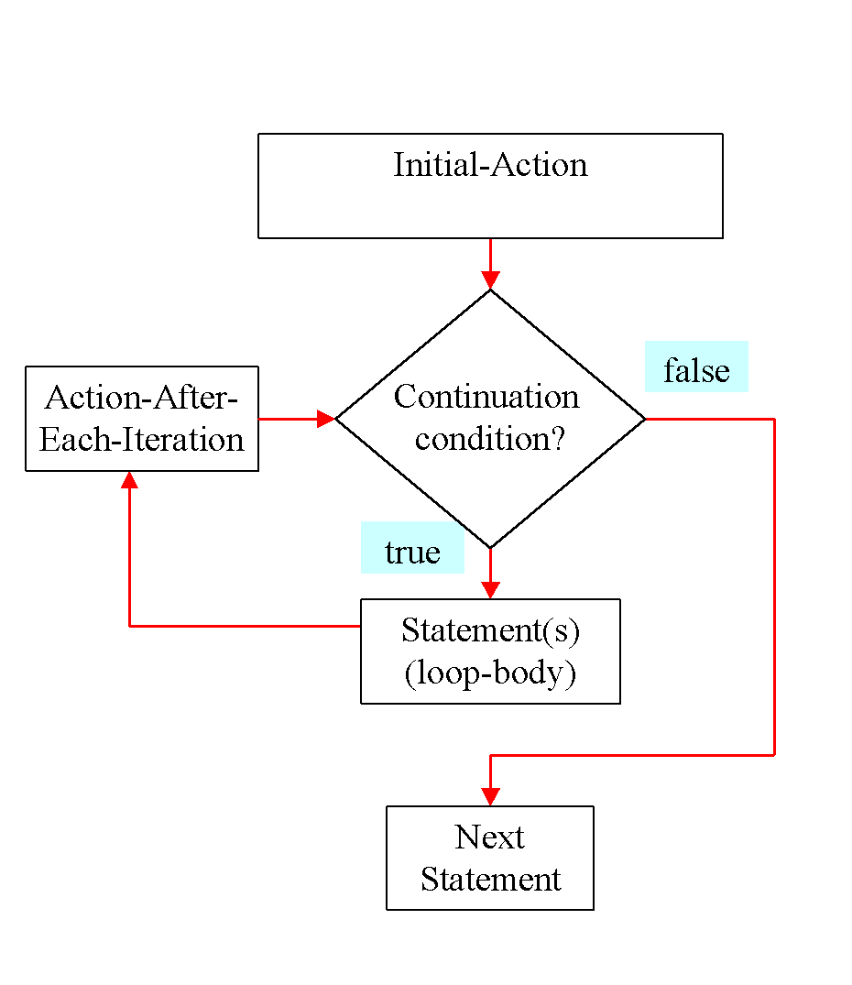
for Loop Flow Chart
for (initial-action;
loop-continuation-condition;
action-after-each-iteration) {
//loop body;
}

Slide 38
Note
Adding a semicolon at the end of the for clause before the loop body is a common mistake, as shown below:
for (int i=0; i<10; i++);
{
System.out.println("i is " + i);
}
Wrong

Slide 39
Note: (cont…)
Similarly, the following loop is also wrong:
int i=0;
while (i<10);
{
System.out.println("i is " + i);
i++;
}
In the case of the do loop, the following semicolon is needed to end the loop.
int i=0;
do {
System.out.println("i is " + i);
i++;
} while (i<10);
Wrong
Correct

Slide 40
for each loop
In Java, there is another form of for loop (in addition to standard for loop) to work with arrays and collection, the enhanced for loop.
Syntax of for-each loop
for(data_type item : collection)
{ ... }

Slide 41
Example:
class ForLoop
{
public static void main(String[] args)
{
char[] vowels = {'a', 'e', 'i', 'o', 'u'};
for (int i = 0; i < vowels.length; ++ i) {
System.out.println(vowels[i]);
}
}
}
class foreachLoop
{
public static void main(String[] args) {
char[] vowels = {'a', 'e', 'i', 'o', 'u'};
// foreach loop
for (char item: vowels) {
System.out.println(item);
}
}
}

Slide 42
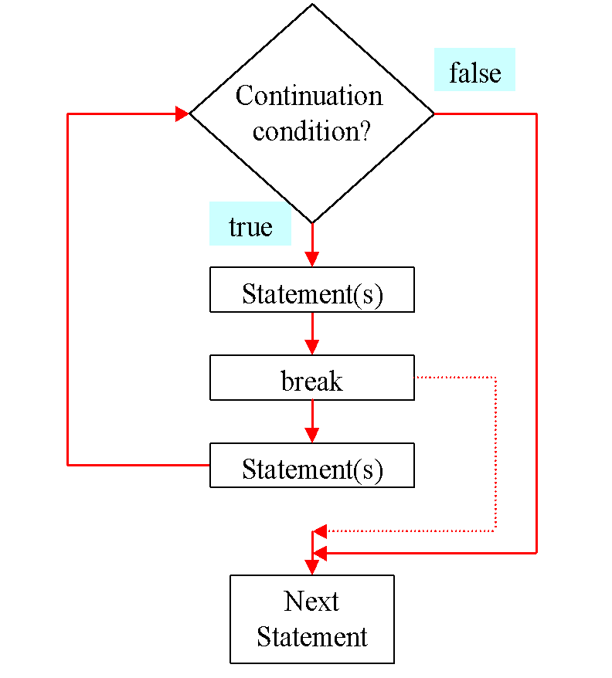
The break Keyword

Slide 43
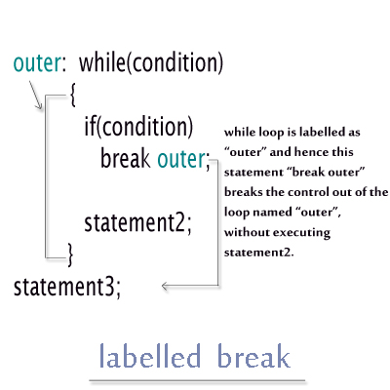
Break with label
In Labelled Break Statement, we give a label/name to a loop.
When this break statement is encountered with the label/name of the loop, it skips the execution any statement after it and takes the control right out of this labelled loop.
And, the control goes to the first statement right after the loop.

Slide 44
Example: 1
public class LabelledBreak
{
public static void main(String... ar)
{
int i=7;
loop1:
while(i<20)
{
if(i==10)
break loop1;
System.out.println("i ="+i);
i++;
}System.out.println("Out of the loop");
} //main method ends
} //class ends
OUTPUT:
i =7
i =8
i =9
Out of the loop

Slide 45
Example: 2
public class LabelledBreak
{
public static void main(String... ar)
{
loop2:
for(int i=0;i<2;i++)
for(int j=0;j<5;j++)
{
if(j==2)
break loop2;
System.out.println("i = "+i);
System.out.println("j = "+j);
}System.out.println("Out of the loop");
} //main method ends
} //class ends
OUTPUT:
i = 0
j = 0
i = 0
j = 1
Out of the loop

Slide 46
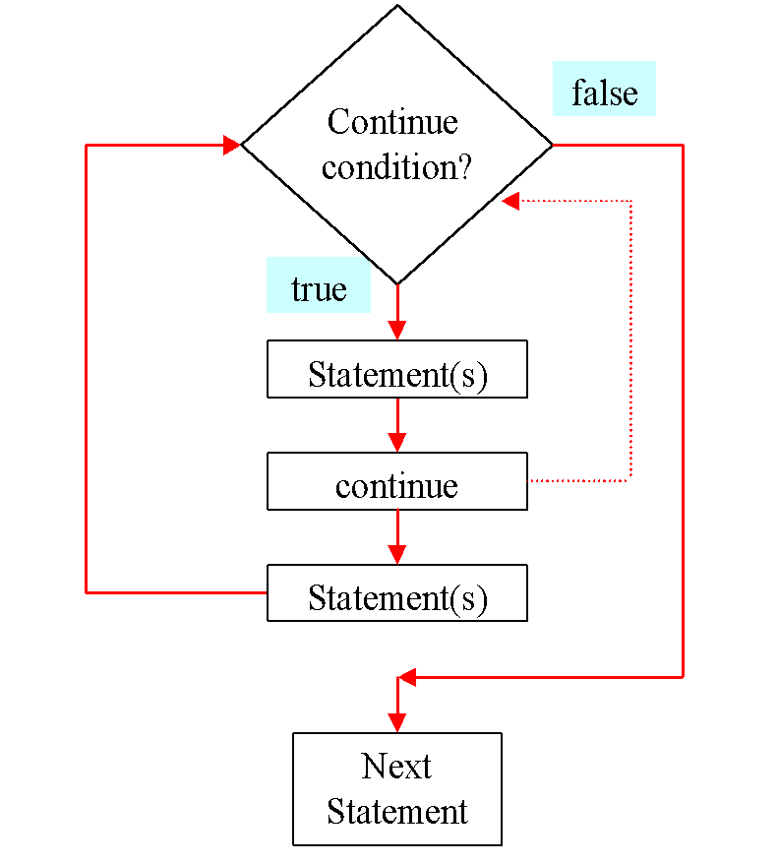
The continue Keyword

